Slide 1

Social Media Campaign Performance Analysis
Rotem Geller & Linoy Yaday

Slide 2
Project Roadmap
1
4
Business Objectives
Data Quality
2
5
Data Sources & Model
General Overview
3
6
Data Preparation
Dashboard & Business Insights

Slide 3
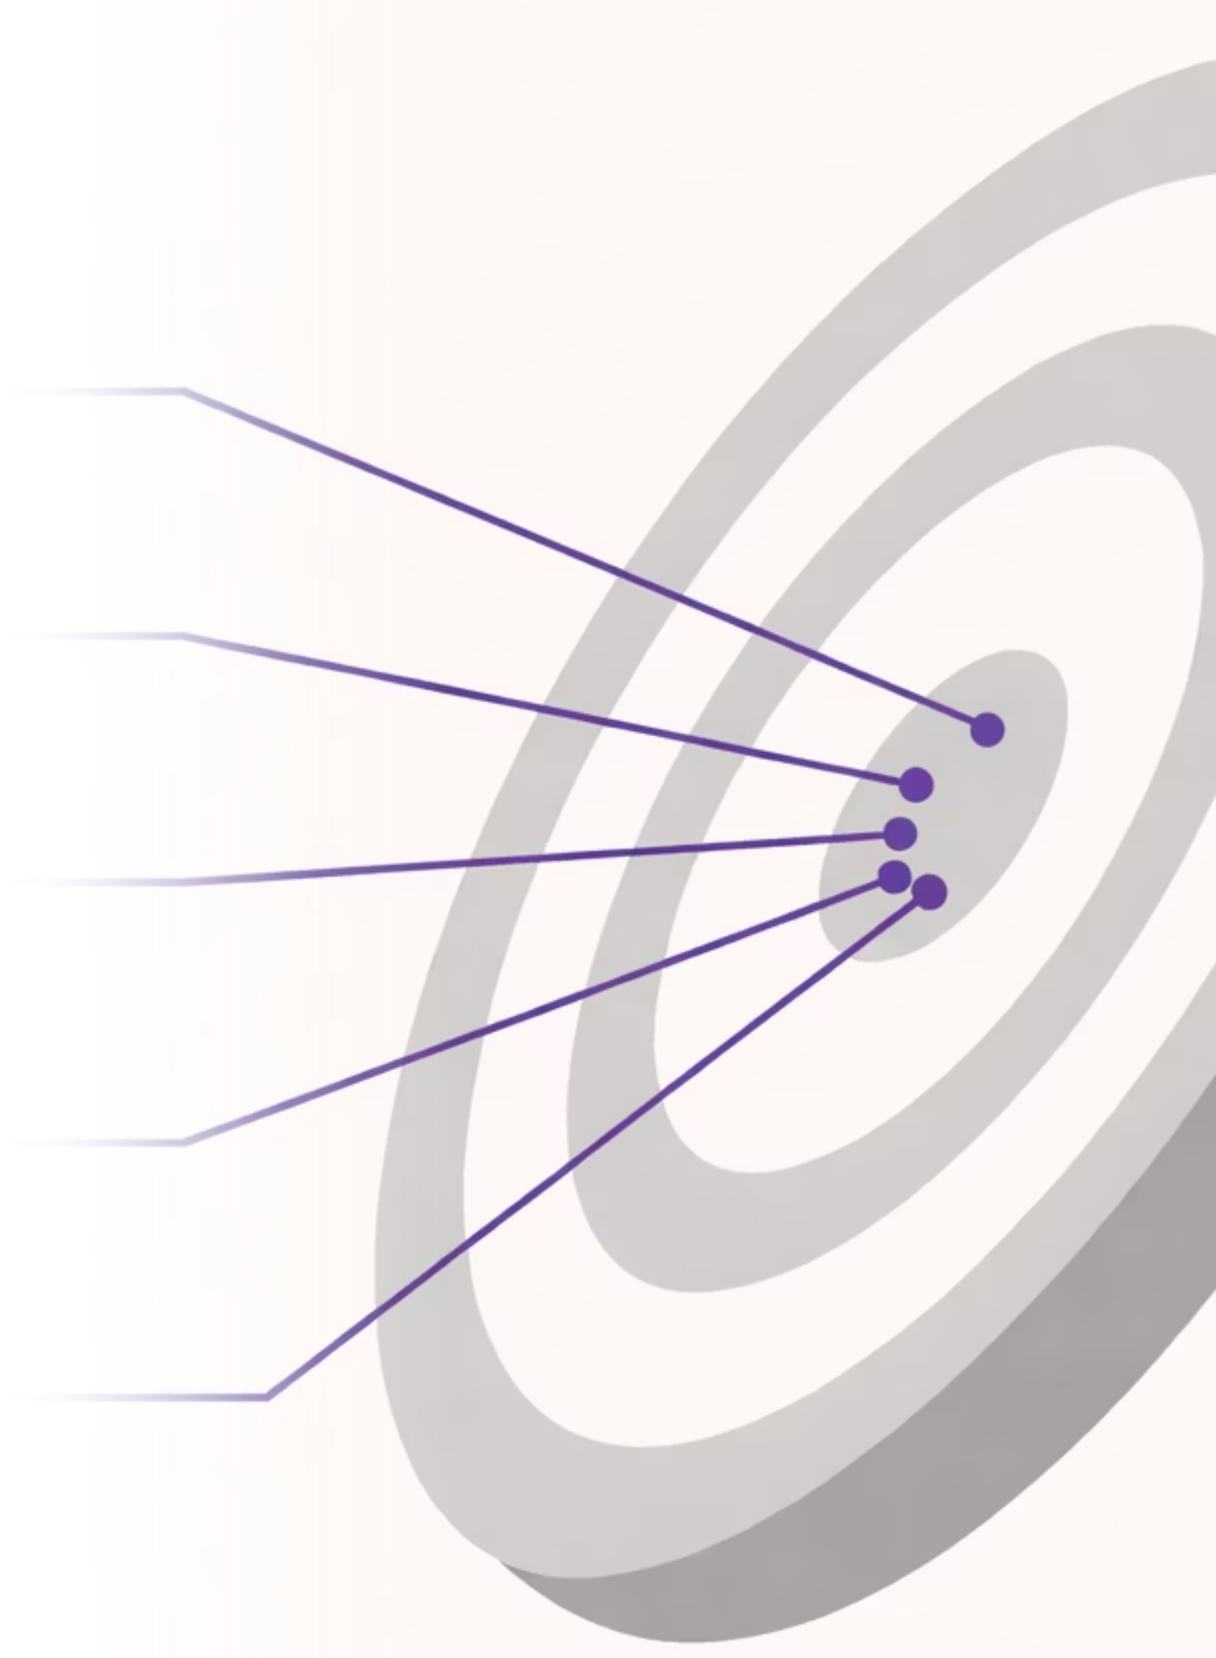
Business Objectives
1
Targeting Match
Does campaign targeting align with actual audience interaction?
2
Funnel Performance
How do campaigns perform across the conversion funnel?
3
Platform & Format
Which platforms and ad types perform best?
4
Engagement Efficiency
Which campaigns generate highest engagement relative to cost and duration?
5
Optimization Decisions
Which campaigns should be extended, optimized, or stopped?

Slide 4

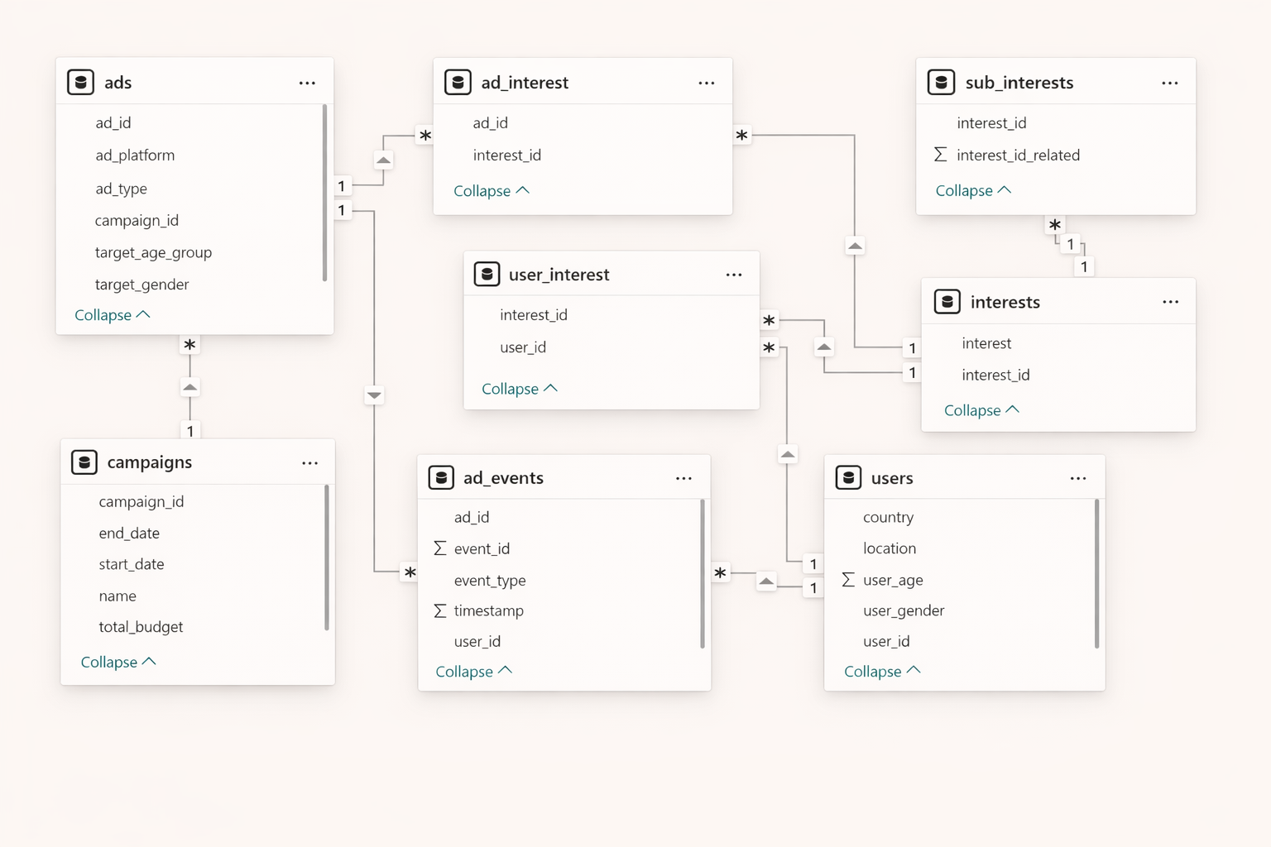
Data Model & Transformation
Consolidated Interest Categories
Dimensional Fact Tables
Relationship Mapping
Feature Development

Slide 5
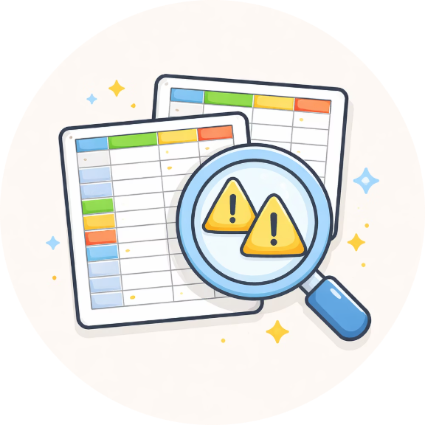
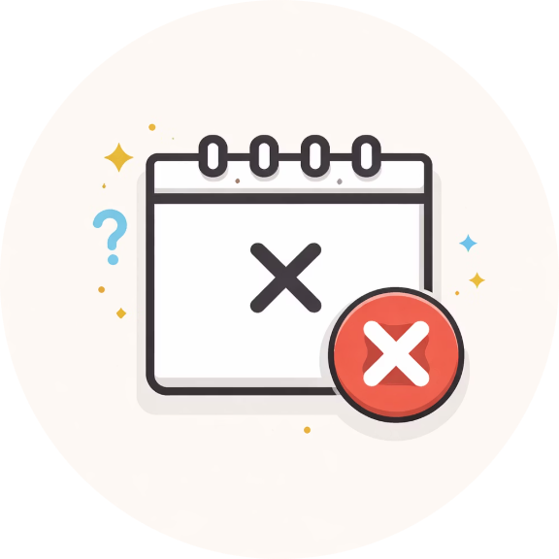
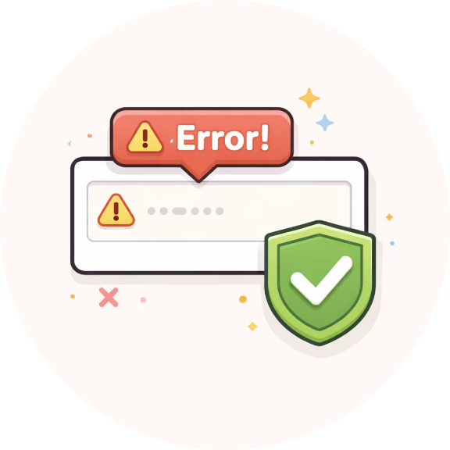

Data Quality & Cleaning
Duplicate Removal
Invalid Events
Field Validation
Referential Integrity
Removed 1.07% duplicate users
Removed events before campaign start
Age ranges, gender values, missing critical fields
Validated relationships across tables

Slide 6
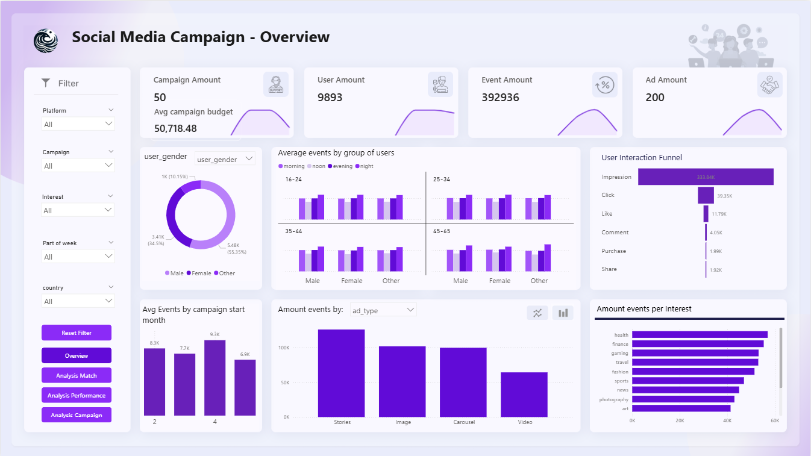

Slide 7
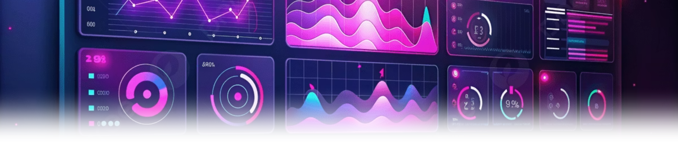


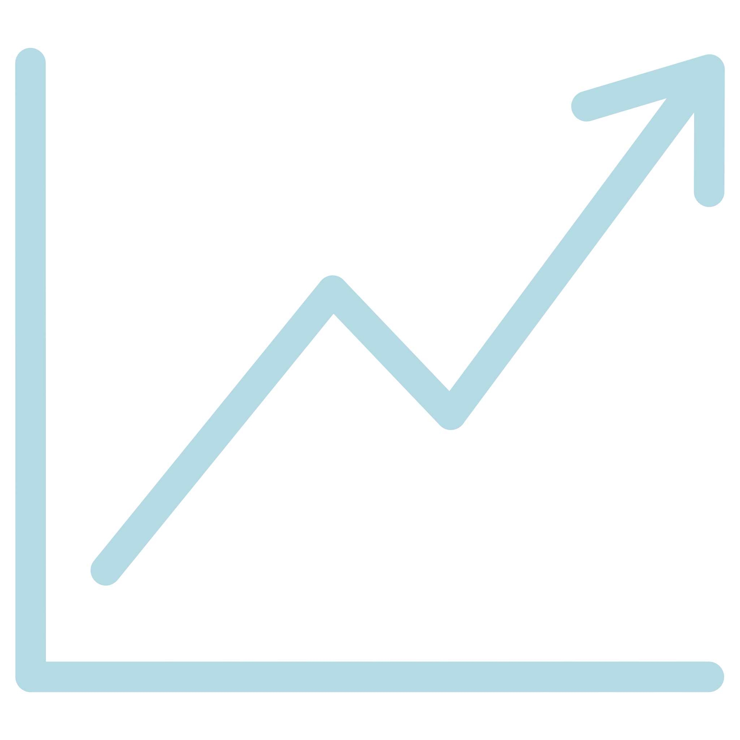

Business Insights & Conclusions
Targeting Effectiveness
Budget Efficiency
Audience targeting is misaligned with actual user behavior, limiting campaign impact.
Higher budgets don't always result in better performance. Longer duration doesn't guarantee improved results.
Platform & Format Performance
Funnel Performance
Ad format drives performance more than platform, with Stories delivering the strongest results.
Strong engagement at the top, but low conversion highlights audience quality gaps.

Slide 8
Thank You
Questions?

